Slide 1
CS4031 Compiler Construction Chapter 4 cont.
Faryal Saud
Lecturer, Department of Computer Science
FAST NUCES CFD

Slide 2
SLR Parser
The SLR(1) parser is a simple LR parser, which is easy to construct. This is better than LR(0) as it uses a look ahead symbol.
The “1” in SLR(1) indicates the number of lookaheads used by the parser. It uses a look ahead given by the follow set.
The procedure for SLR(1) parsing table is the same as LR(0); the only difference is in reduce entries.

Slide 3
SLR Parser
To place reduce entries once again, SLR(1) uses the DFA.
It checks if a state has the final item.
The state that contains a final item indicates in which row the reduce entries are to be placed. This procedure is the same as LR(0).
For example, if state Ii has a final item, we place reduce entries in row “i.” But in row “i,” finding out columns is different for SLR(1). If it is LR(0), we place under every column, but for SLR(1) it is under the columns given by the follow set

Slide 4
Example:
Consider the following grammar
E → T + E | T
T → a

Slide 5
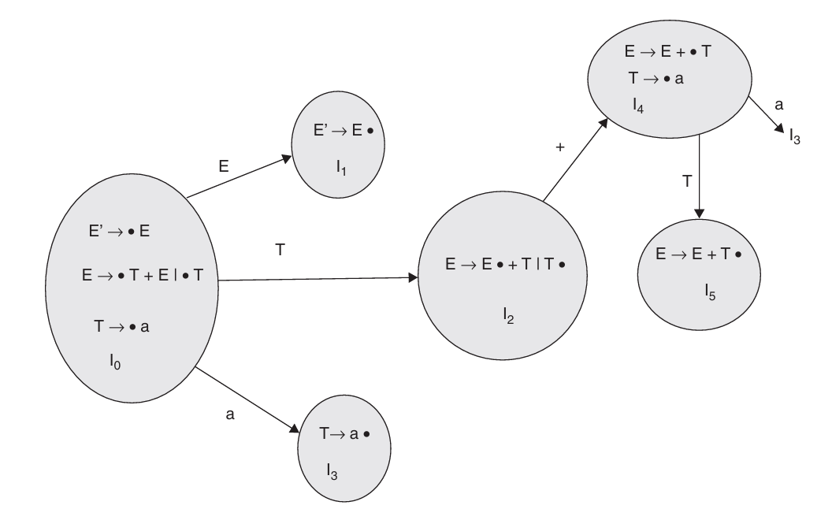
SLR Parser : DFA Machine

Slide 6
SLR Parser
Find the follow of the Non-Terminals
E → T + E | T
T → a
Follow of E {$}
Follow of T { +, $}

Slide 7
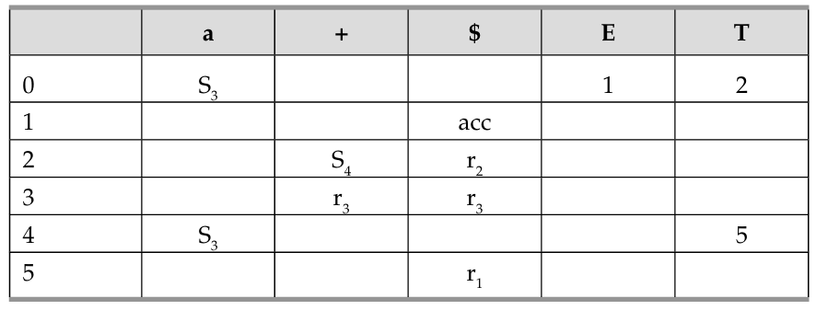
SLR Parser : Parsing Table

Slide 8
SLR Parser : Example
Check whether the given grammar is suitable for SLR(1) parsing or not
S → A a A b | B b B a
A → ε
B → ε

Slide 9
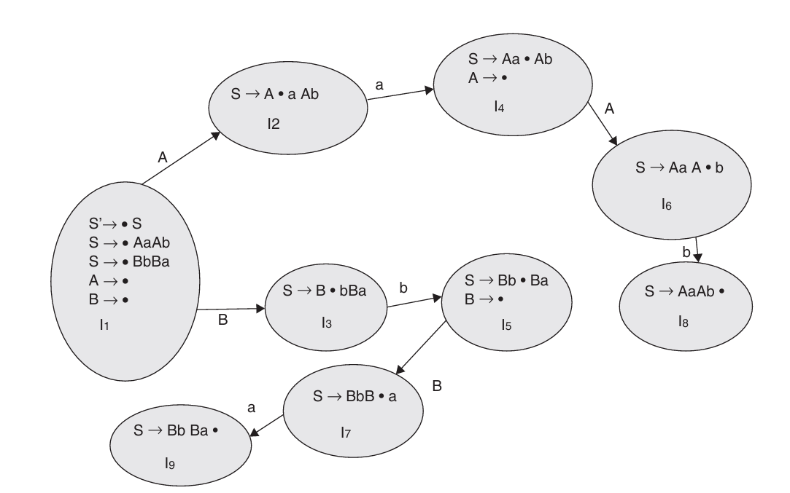


SLR(1) Machine for the given grammar
S` →S.
$$I_{1}$$
$$I_{0}$$

Slide 10
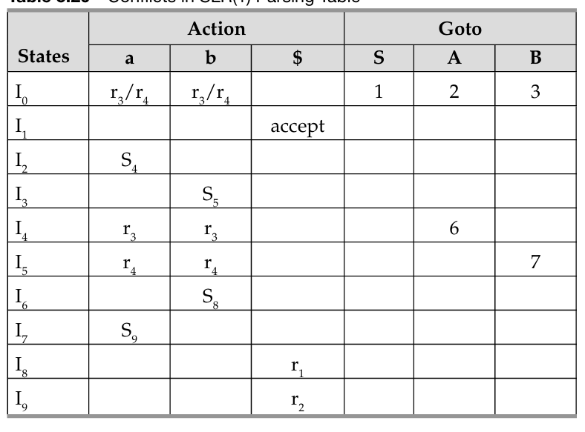
Parsing Table

Slide 11
SLR (1) Example
Consider the following grammar
S → cAd
A → ab | e
Augmented Grammar
S → S’
S → cAd
A → ab
A → e

Slide 12
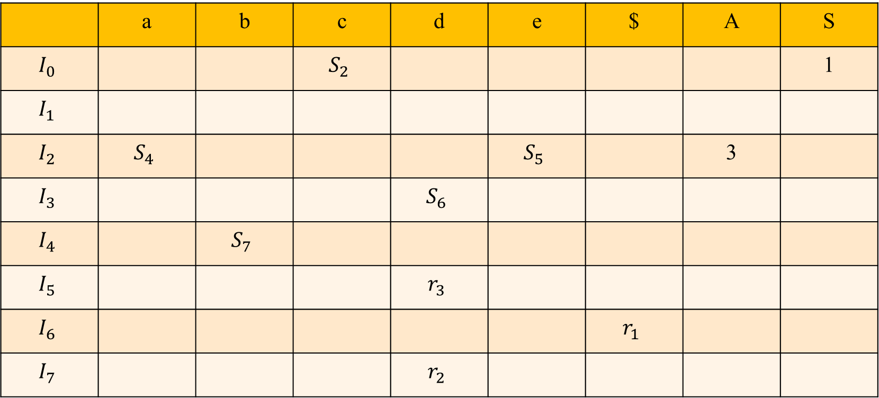
SLR(1) Grammar: Parsing Table
 | a | b | c | d | e | $ | A | S
$$I_{0}$$ |  |  | $$S_{2}$$ |  |  |  |  | 1
$$I_{1}$$
$$I_{2}$$ | $$S_{4}$$ |  |  |  | $$S_{5}$$ |  | 3
$$I_{3}$$ |  |  |  | $$S_{6}$$
$$I_{4}$$ |  | $$S_{7}$$
$$I_{5}$$ |  |  |  | $$r_{3}$$
$$I_{6}$$ |  |  |  |  |  | $$r_{1}$$
$$I_{7}$$ |  |  |  | $$r_{2}$$

Slide 13
Parsing Table : ced$
Stack | String | Action
$0 | ced$ | Shift s2
$0c2

Slide 14
Canonical LR(1) Parsers CLR(1)/LR(1)
The CLR parser stands for canonical LR parser. It is a more powerful LR parser.
It makes use of lookahead symbols.
This method uses a large set of items called LR(1) items.
The main difference between LR(0) and LR(1) items is that, in LR(1) items, it is possible to carry more information in a state, which will rule out useless reduction states.
This extra information is incorporated into the state by the lookahead symbol

Slide 15
Need of CLR Parser
In the SLR parser, there is a problem of shift / reduce conflict even if the grammar is unambiguous.
This is due to the fact that the SLR parsers uses the FOLLOW() information to perform a reduce action by matching the stack information with input symbol.
However the FOLLOW() information alone is not sufficient to decide when to reduce. Hence, powerful parser is required.

Slide 16
Steps of CLR Parser
The steps involved in the CALR parser are as follows:
Construct LR(1) items – This is in contrast with the LR(0) items that is constructed for the SLR parser. This also uses Closure() and goto(), but the algorithm for these two functions are different.
LR(1) items are used to construct the CALR parsing table involving action, goto.- The parsing table resembles SLR parsing table but has more states and there is little variation in the construction procedure.
Use this table, along with input string and a stack is used to parse the string – The parsing action is same as the SLR parser’s algorithm

Slide 17
CLR (1) Parser
Consider the following grammar
S → AA
A → aA | b

Slide 18
CLR (1) Parser
Step 1: generate the augmented grammar
S’ → .S
S → .AA
A → .aA |.b

Slide 19
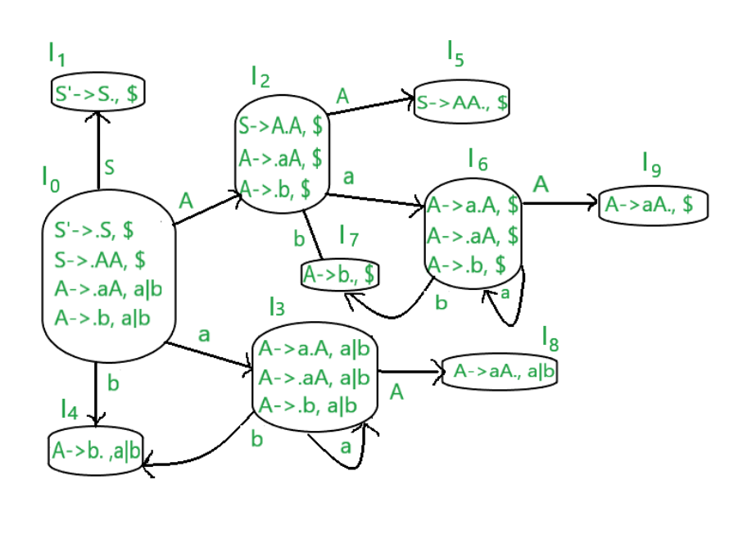
CLR (1) Parser

Slide 20
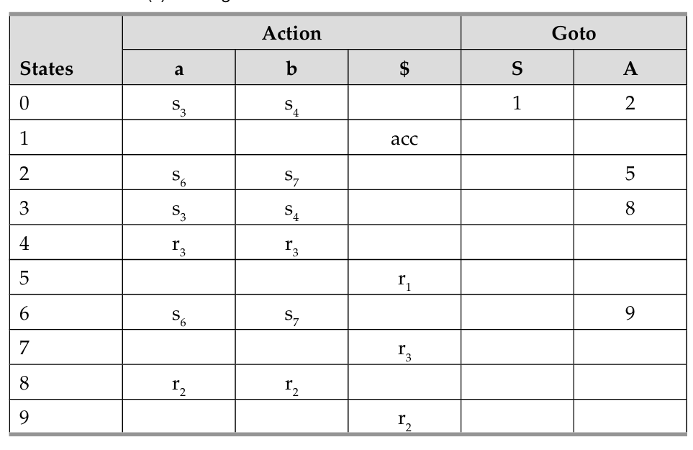
CLR (1) Parsing Table

Slide 21
Example:
Check whether the given grammar is suitable for CLR(1) parsing or not
S → A a A b | B b B a
A → ε
B → ε

